Slide 1

Personalized Carrier Recommendation System
Date: 10/10/2025
Degree: B.Tech CSE ML&AI
Project Guide:
Ms. Shruti Mishra
Jitendra Chaudhary (22SE02ML095)
School of Engineering, P P Savani University, Surat, Gujarat, India-394125

Slide 2
Title: Personalized Carrier Recommendation System
Objective:
The objective of this project is to design and develop an AI-powered career recommendation and skill tracking system that provides personalized job suggestions based on a user’s skills, interests, experience, education level, salary expectations, and work preferences.
2

Slide 3
Introduction / Problem Statement
This project aims to simplify career selection by providing accurate, AI-driven job recommendations. Unlike traditional portals, it combines machine learning (Random Forest) and semantic similarity (Cosine / BERT) to analyze both user profiles and job data, offering precise and meaningful matches.
Problem Statement: Job seekers often receive irrelevant results due to keyword-based systems. There is a need for a personalized AI system that considers multiple user factors like skills, education, automation risk, and experience to recommend the most suitable careers.
3

Slide 4
Scope of Work
Build a Python-based recommendation model.
Design a web interface using HTML, CSS, and JavaScript.
Use hybrid AI (Cosine Similarity + Random Forest).
Provide accurate job recommendations with details like title, salary, and industry.
4

Slide 5
Methodology / Proposed Approach
Data Preprocessing: Cleaned and encoded job dataset.
Hybrid Model: Combined text similarity and Random Forest predictions.
User Input: Collected via CLI/Web form.
Recommendation: Generated top 5 jobs based on similarity and suitability.
5

Slide 6
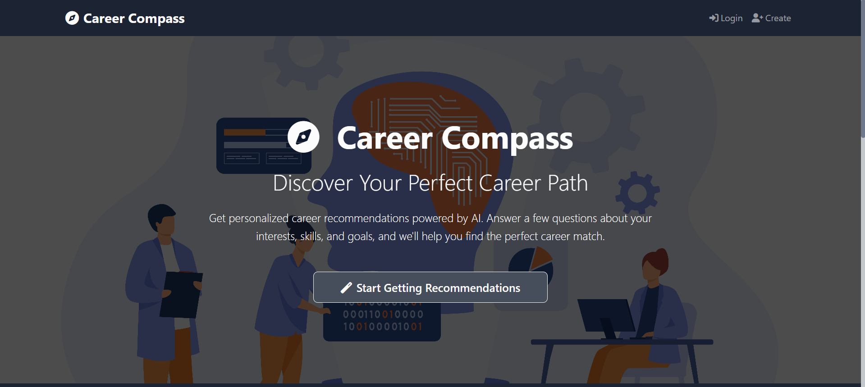
Methodology / Proposed Approach
User Interface: A simple web page with login and input forms for collecting user details and displaying recommended jobs. Built using HTML, CSS, and JavaScript.
6

Slide 7
Current Progress
✅ Data cleaned and preprocessed
✅ Hybrid model implemented
✅ CLI version working
✅ Web interface created
🔄 Integration and skill tracking module under progress
7

Slide 8
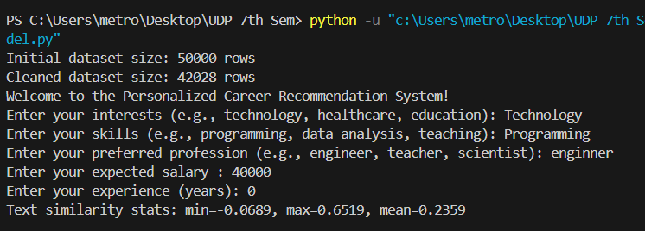
Test Run:
Model tested locally with sample Inputs:-
8

Slide 9
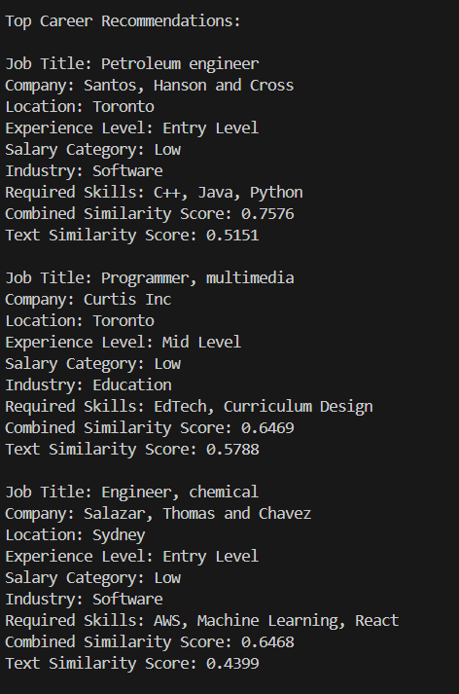
Test Run:
9

Slide 10
Challenges Faced & Possible Solutions
Challenge | Solution
Limited data | Used pseudo-labeling & hybrid scoring
Low text accuracy | Added Sentence-BERT embeddings
Integration issues | Plan to connect via Flask API
10

Slide 11

FUTURE SCOPE
Add skill tracking & learning roadmap.
Integrate live job data and analytics.
Deploy full web app with database and visualization.
Future scope of system
11

Slide 12
THANK YOU..!!
T004/ Version 1.0

